Slide 1

Columbia Asia Hospital Analysis

Slide 2

Overview of Hospital Analysis
Columbia Asia is a multinational chain of hospitals and one of the largest and fastest-growing healthcare companies in Southeast Asia.
Columbia Asia hospital generated 500+ Million of revenue based on the data which is provided.
Hospital is also ready to hire the new talent in few departments as well. Such as Renal and Gastroenterology departments.
Considering the hospital’s revenue, Hospital is ready to roll out discounts offers as well where in we have discussed this in our report and our documentation as well. We have implemented strategies where we can evaluate and assign the discounts.

Slide 3
Data Cleaning for Robust analysis
Before loading a Columbia Asia Hospital file into an analysis, it is important that the spreadsheet is free from irrelevant information and has a good structure to prevent misinterpretation.
We can clearly see patient_sat_score has null values. I replaced the null values with 0 value. So that, it will make easier for us to get the proper insights from our data.
Secondly, I observed the columns Appointment fees and Total bill has Format Currency which is correct but while looking at these columns it looks like any other column of numbers. To visualize better, I entered dollar sign to make it look like a currency.

Slide 4
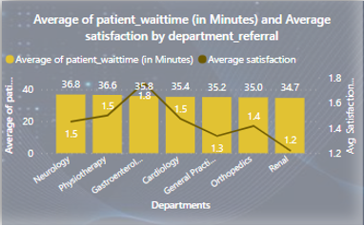
Revenue Evaluation
We have visualized and compared revenue across different hospital departments.
Identified average waiting times and discuss potential improvements for each departments.
Discussed the total number of visits to each department based on referrals and Identified the most frequently visited departments which helps us to generate the overall revenue.
Identify areas for improvement in Patient experience, Average Satisfaction by Demographics.

Slide 5
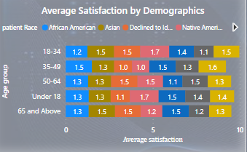
Subjective Insights
Patient Satisfaction & Wait Time: Unveiled the Connection
Investigated the relationship between patient wait time and satisfaction scores.
Highlighted insights and potential areas of improvements which have contributed to the Doctor’s insights.
Demographic Patterns: Impact on Department Visits
Explored how patient demographics such as Age group affect the frequency of visits to different departments.
Presented patterns and insights for targeted strategies such as tiered discount strategy to roll out the Discounts for specific Patients.

Slide 6
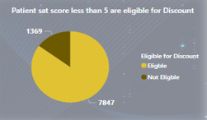
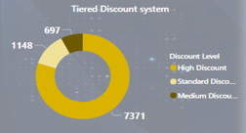
Strategy Recommendations
Patient Discount Strategies:
Proposed strategies for assigning patient discounts.
Discussed the criteria where average , for effective and fair distribution.
Strategic Hiring: New Doctors in Focus:
Suggest departments where average waiting time was considerably high and seems unusual for that department. Hence hospital was planning to hire 2-3 new doctors.
Base recommendations on patient visits, revenue, and wait times such as patient’s total profit coming from specific department, but the average wait time does not match the criteria.

Slide 7
Average Satisfaction Scores
The patient’s satisfaction scores depends on the doctors waiting time and the visit of patients in the Departments.
Hence, if we observe the patient wait time in each department we can see Renal department has the lowest number of patients visit and General Practice department leading with the highest number of patient visit.

Slide 8


